Slide 1
Hands-On Exercise 1: Image Classification
Julia Owen, PhD
University of Washington

Slide 2
Setting up today’s classification problem
Classifying images using DL is an important area of clinical application in ophthalmology
Today we will explore a toy DL problem, but everything we learn can be applied to real-world challenges

Slide 3
In the AI-READI dataset, we have CFPs from 4 imaging devices
These 4 devices create images that are fairly distinct in color and the classification problem is not very difficult. So we design a more difficult problem.

Slide 4
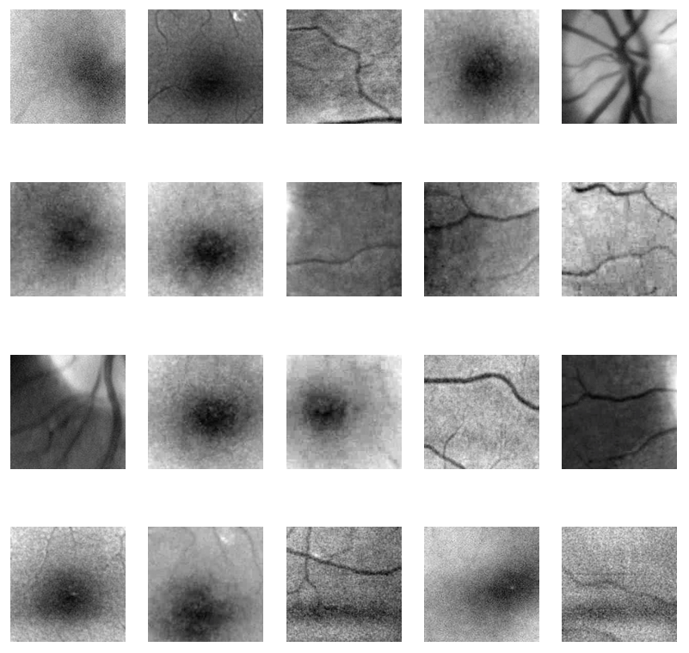
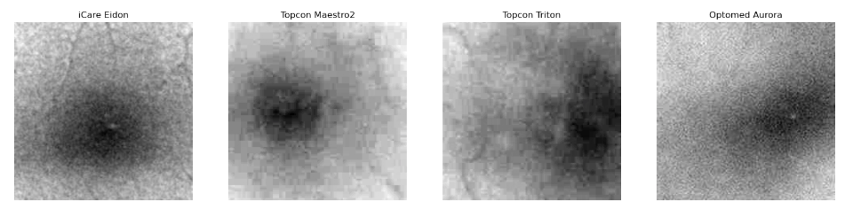
Can you classify these images derived from the images on the previous screen?

Slide 5
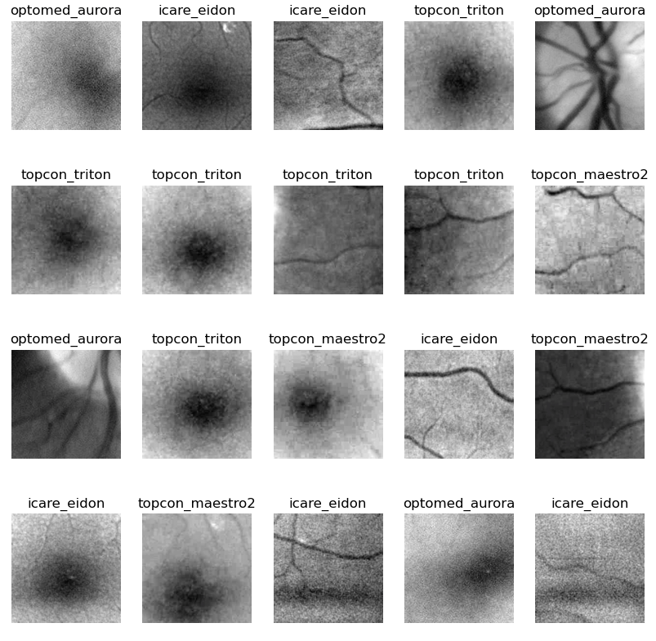

Slide 6
So our challenge today is to develop a deep learning model to classify the device from these cropped, grayscale images.
This will demonstrate the power of deep learning.

Slide 7
Today’s plan
Introduce you to Jupyter notebooks
Make the plots I just showed you
Set up a deep learning model to perform the task we tried to do by eye
Train the model
Examine the results
Explore other settings to improve performance

Slide 8
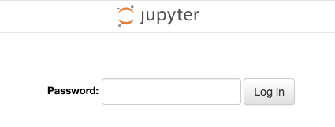
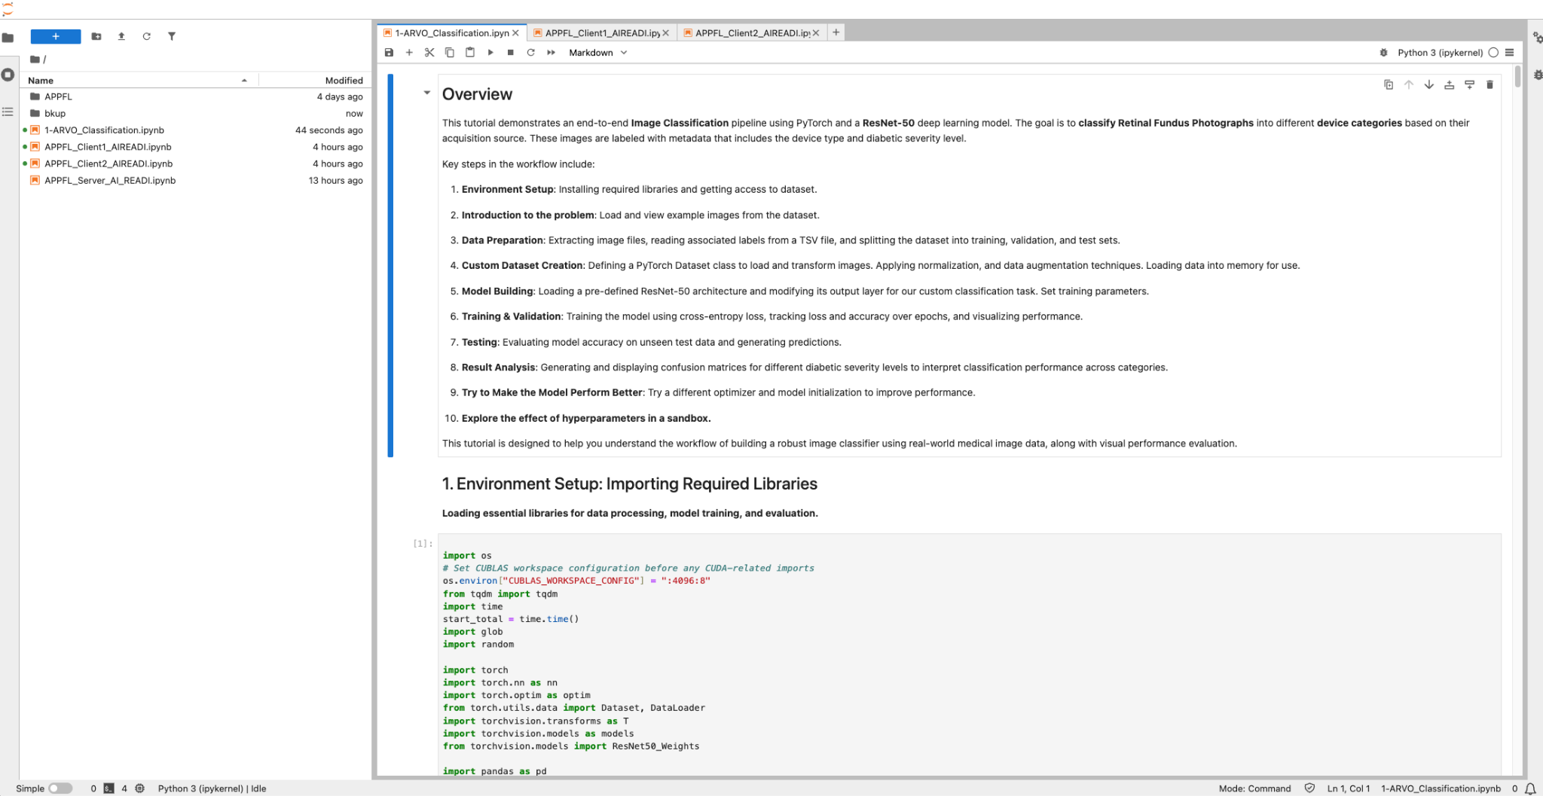
Let’s get everyone logged onto an instance
Type the url you were given into an internet browser, example http://5.936.198:8027
Type in the password: AIREADI#2025
You should be in and see a screen like this

Slide 9
Run the current cell
Stop the current cell
Restart the kernel, resets things
Files in directory
Blank: never been run
Number: finished running (numbers are sequential)
*: The code is still running.
Notebooks are an interactive way to write and run code.
Do not run the cells out of order!

Slide 10
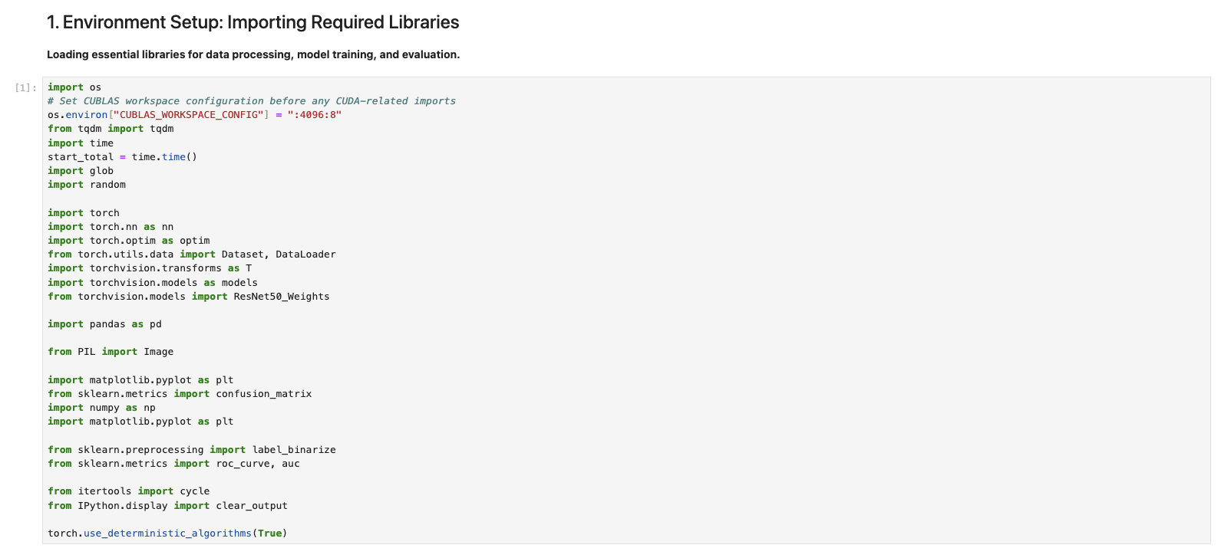
Ok now we are ready to start training a model!

Slide 11
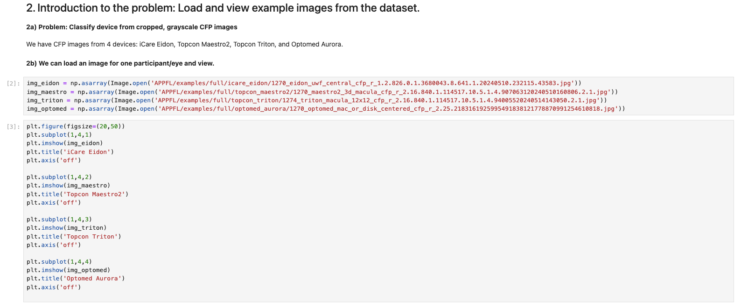

Slide 12
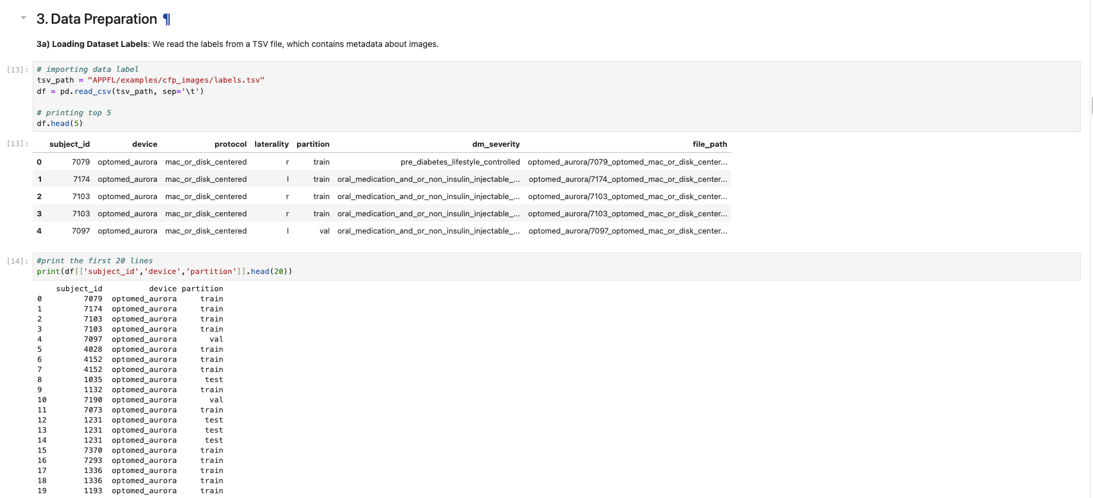

Slide 13
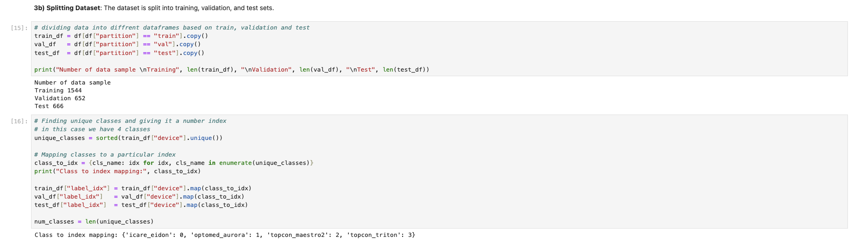
2,862 images total
Roughly 60-20-20 split
54% is from training set -> will be used to train our model
23% is for validation -> will be used to evaluate model during development period
23% is for testing -> will be saved for the end when we evaluate our model
Patient-level split - no leakage between the partitions

Slide 14
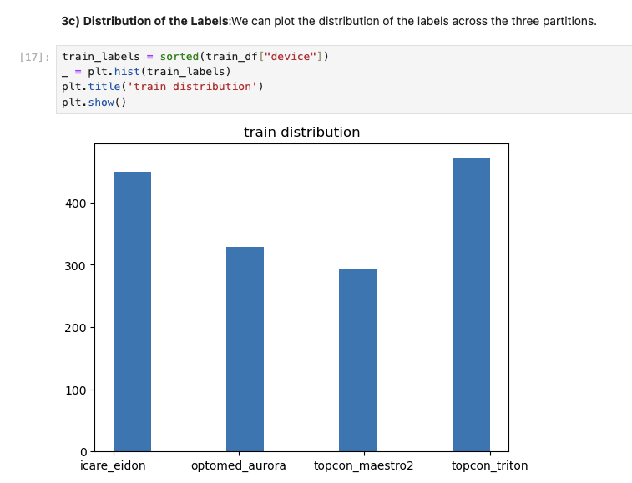
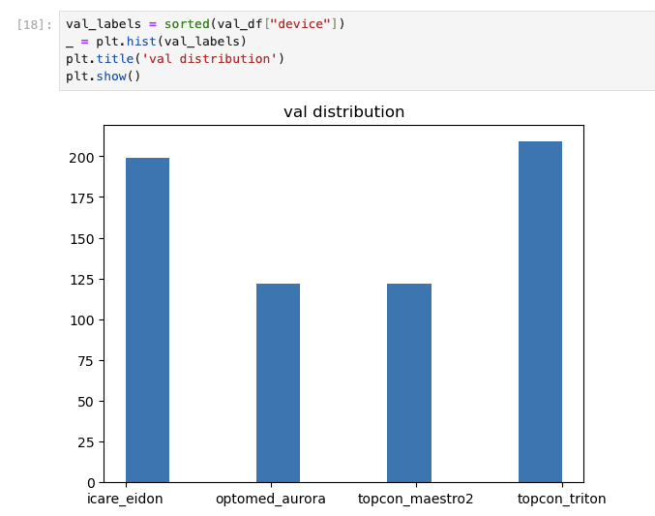
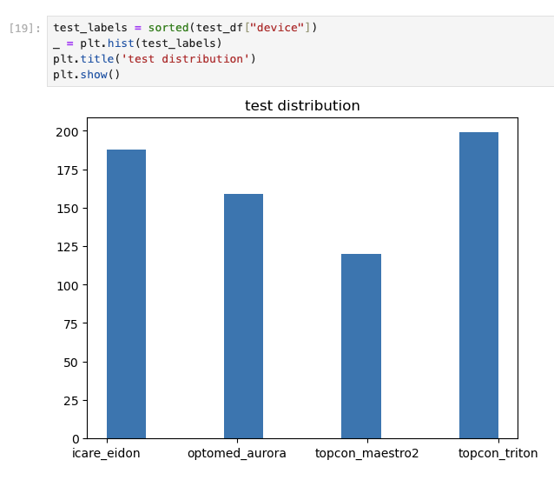

Slide 15
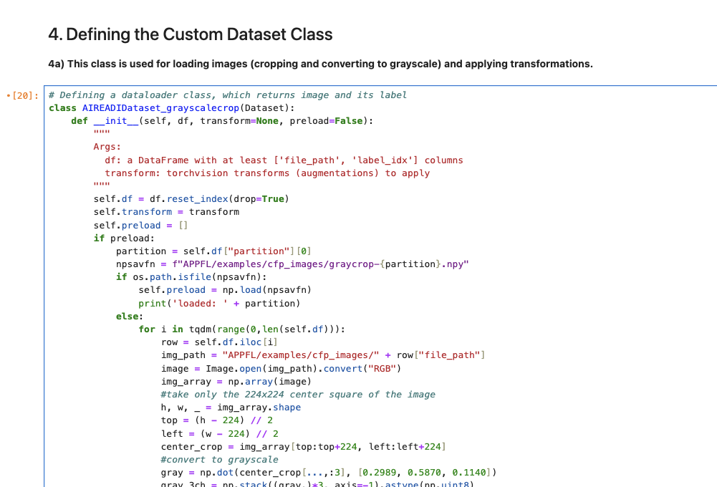
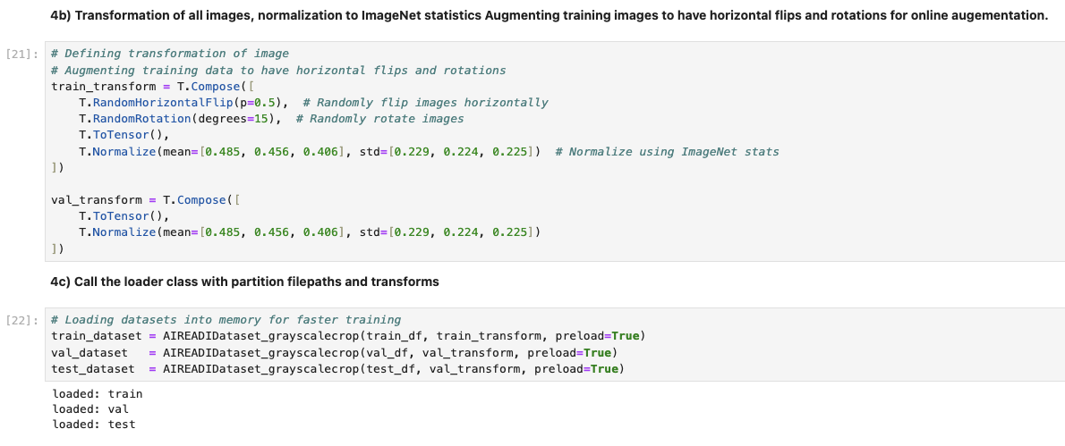
Image augmentation, helps prevent overfitting and helps with generalization (especially with small datasets)

Slide 16
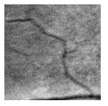
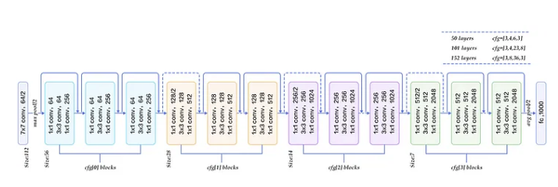
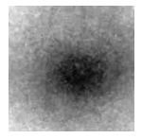
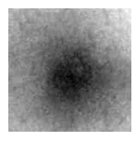
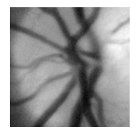
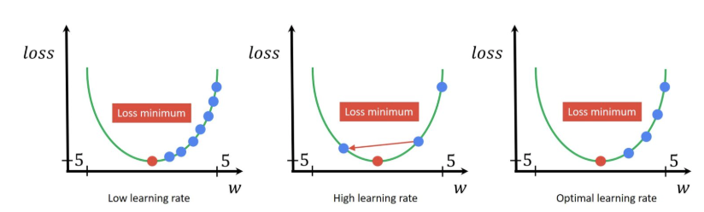
Quick review of deep learning fundamentals
True Labels:
0 = iCare Eidon
1 = Optomed Aurora.
2 = Topcon Maestro2
3= Topcon Triton
Loss function:
Cross Entropy
ResNet-50
Predicted Labels:
0 = iCare Eidon
1 = Optomed Aurora.
2 = Topcon Maestro2
3 = Topcon Triton
Batch Size:
The number of images to use to compute each step
Number of epochs:
The number time to go through the whole training set
Optimizer and learning rate

Slide 17
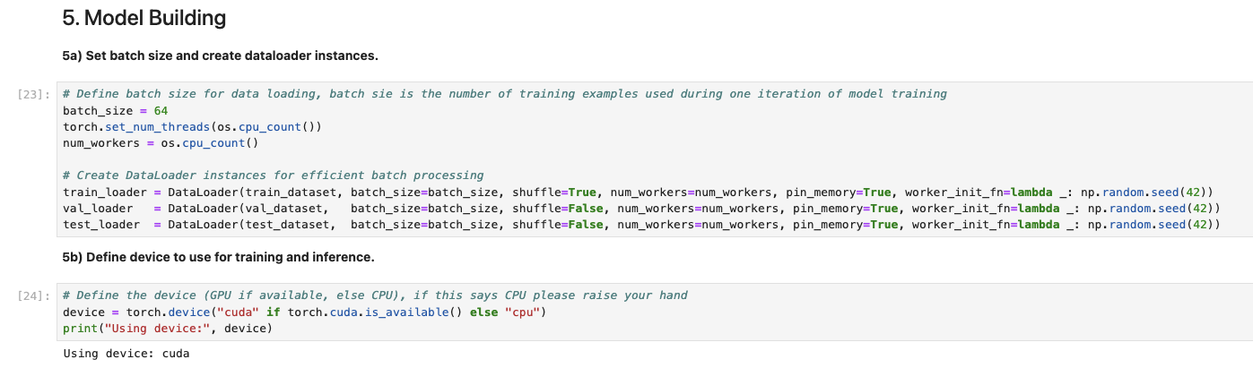
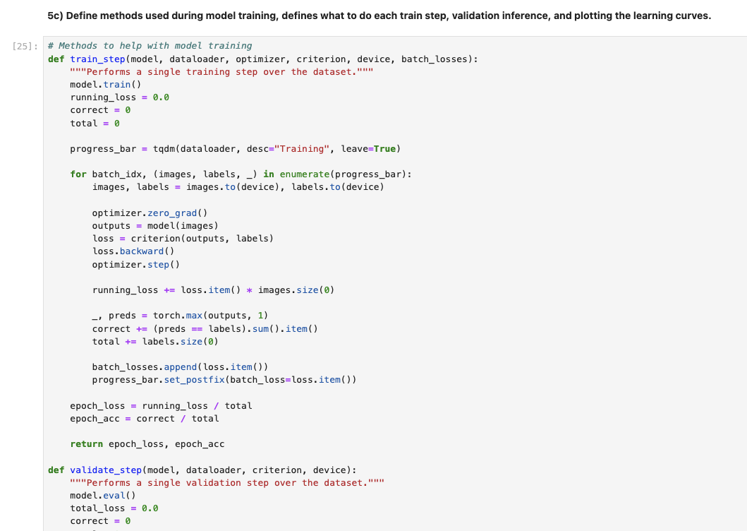

Slide 18
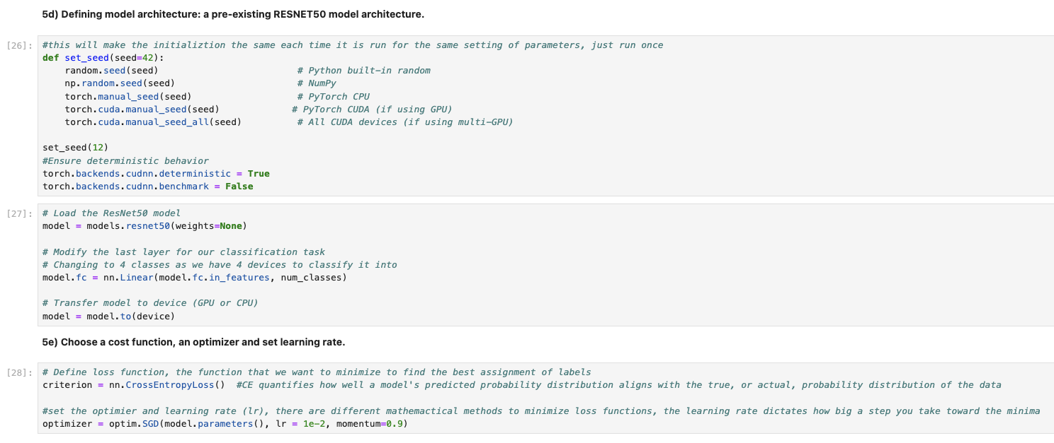

Slide 19
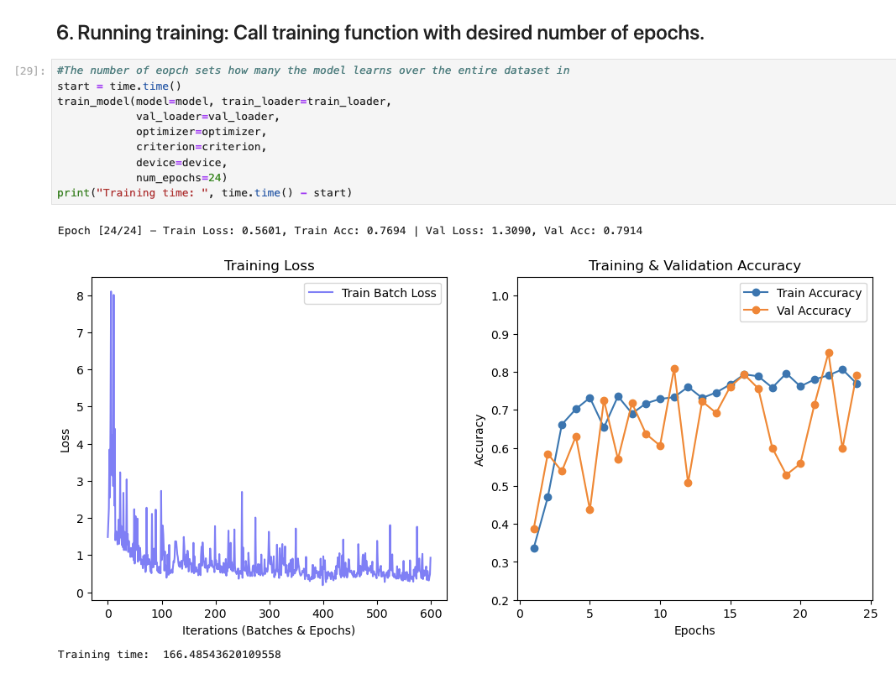
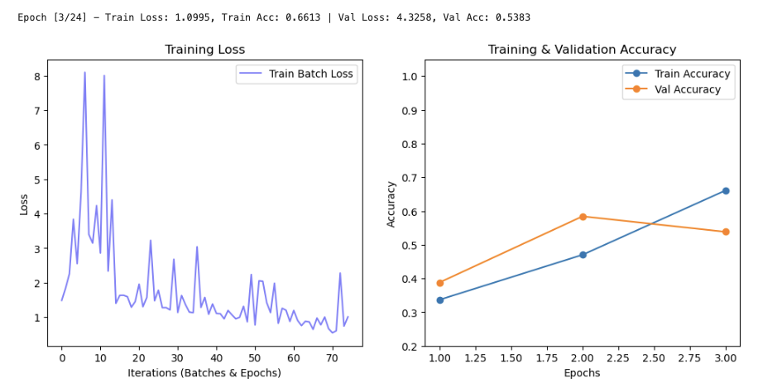
Start training

Slide 20
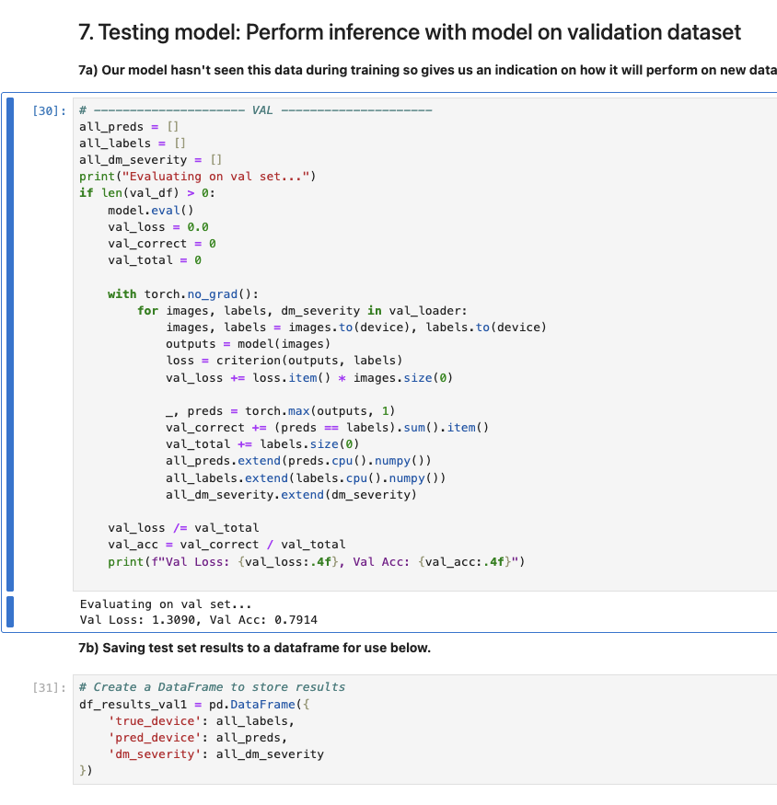

Slide 21
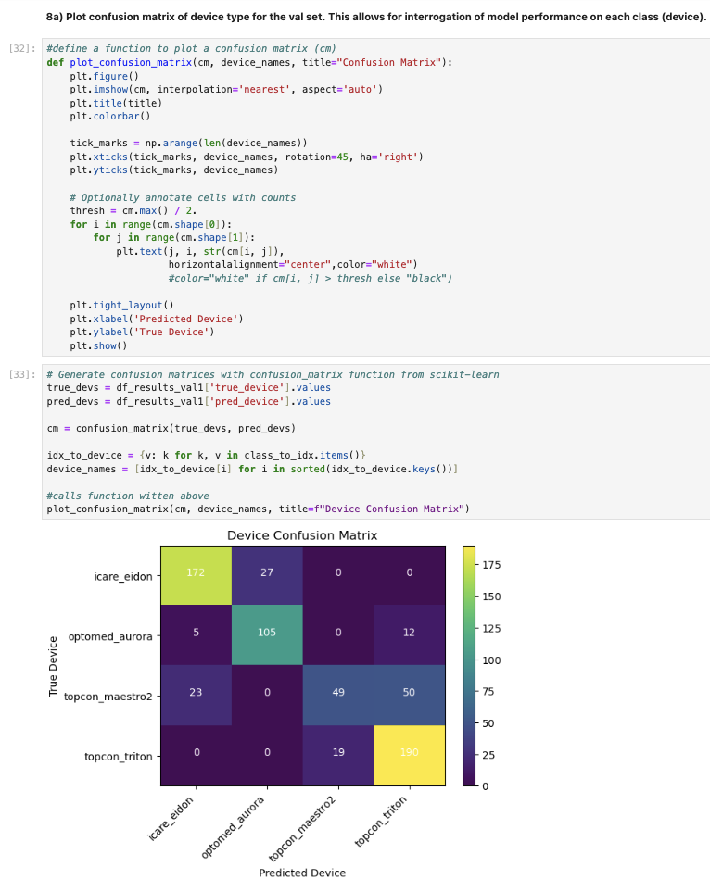

Slide 22
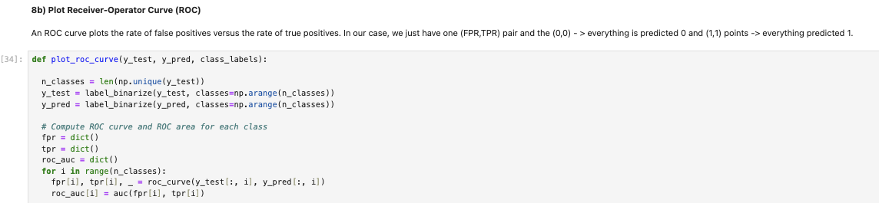
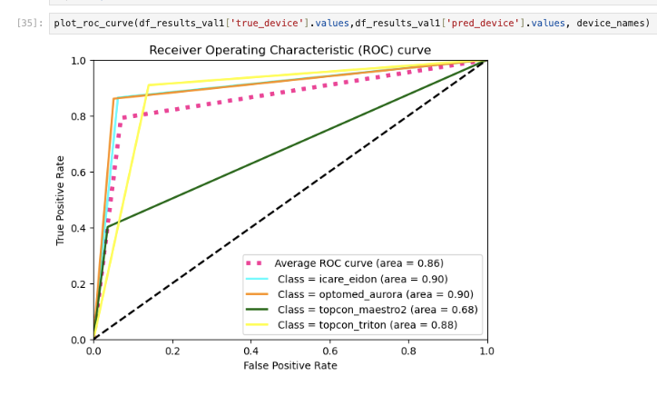
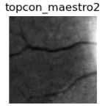
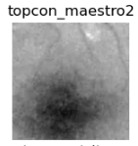
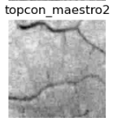
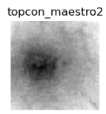
If we consider the topcon_maestro2 class:
True positive - correctly labeled topcon_maestro2
False positive - image incorrectly labeled topcon_maestro2

Slide 23
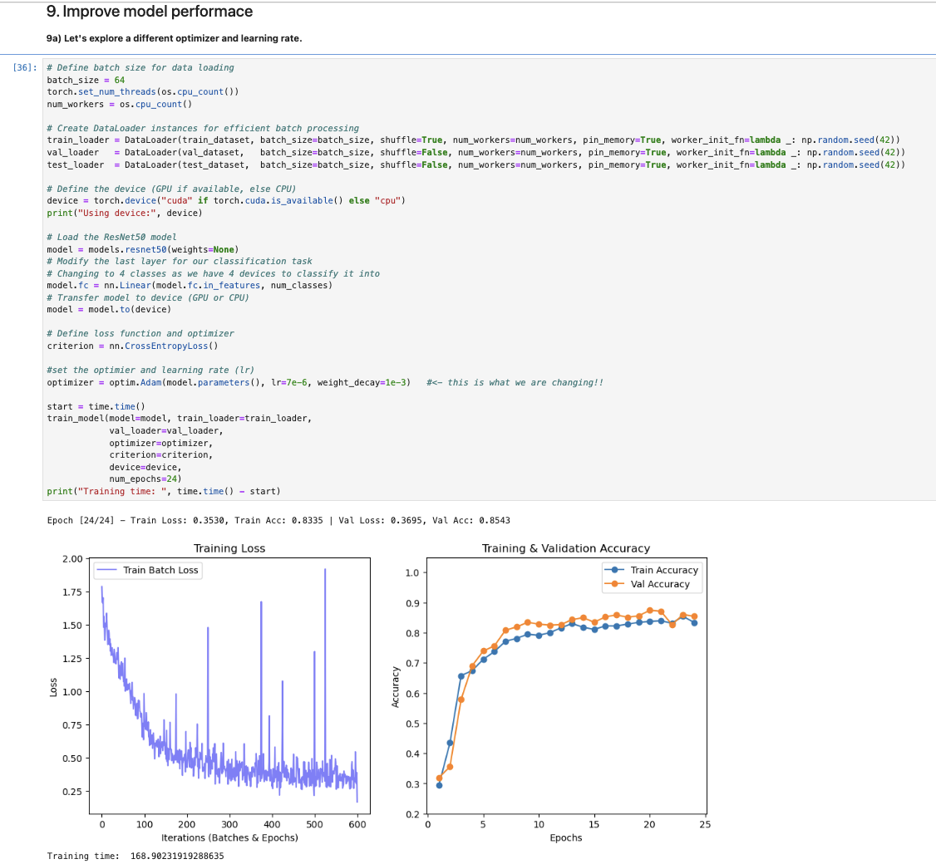
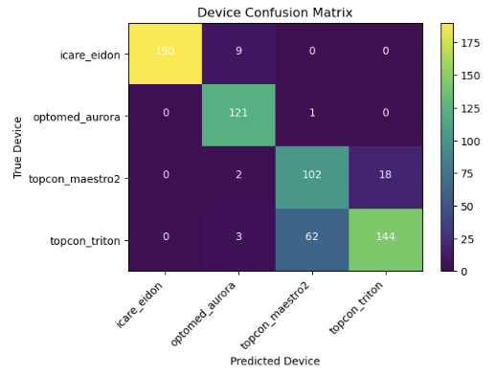
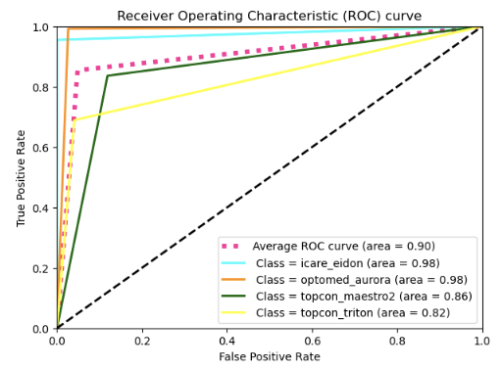
Run the next 3 cells
Start training

Slide 24
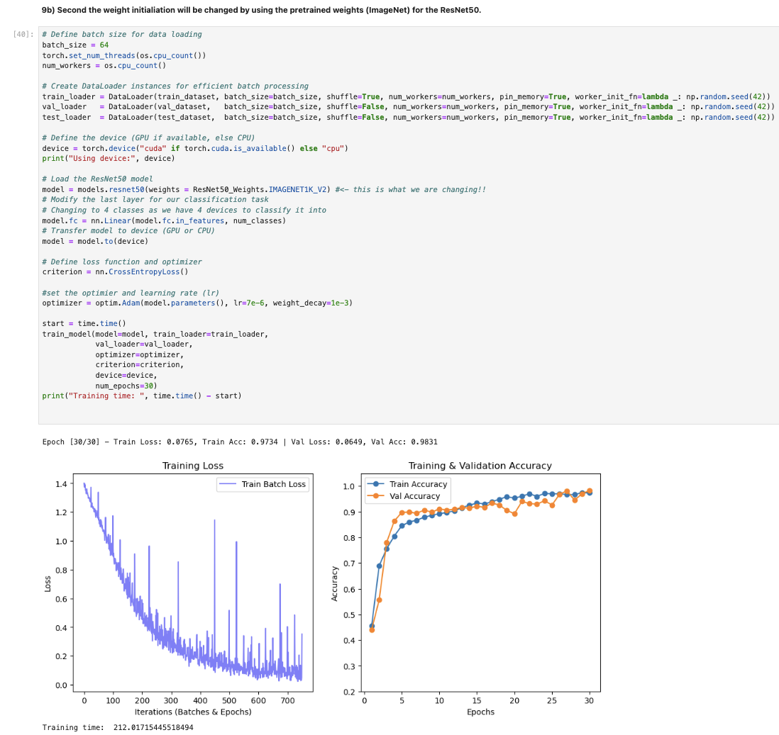
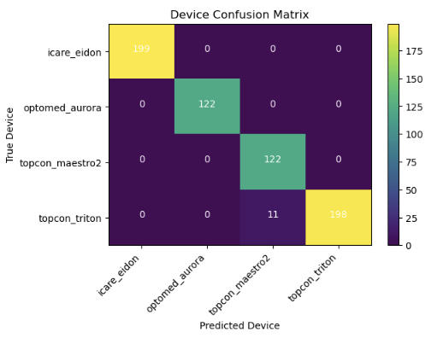
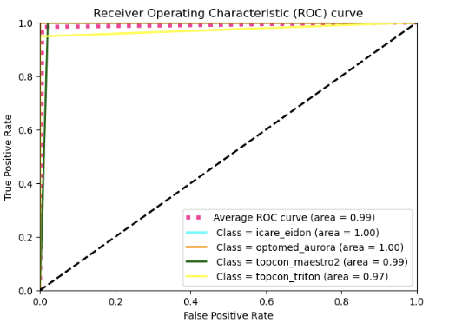
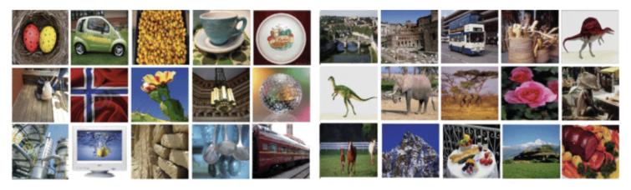
Run the next 3 cells
Start training

Slide 25
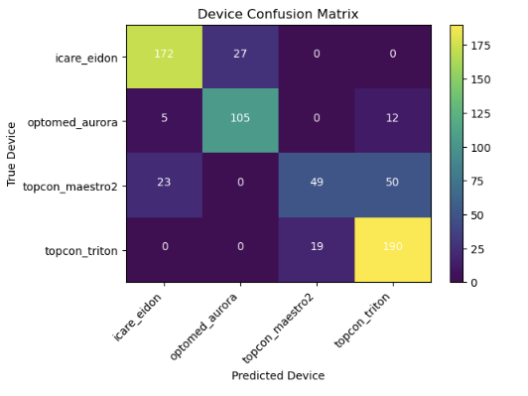
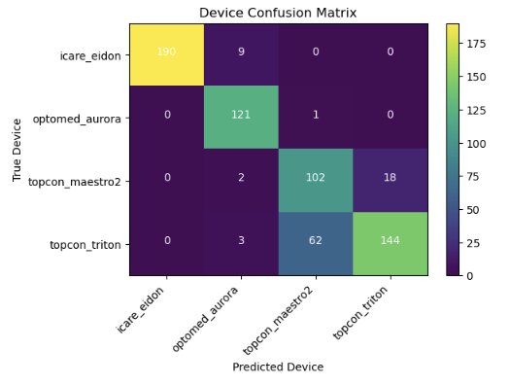
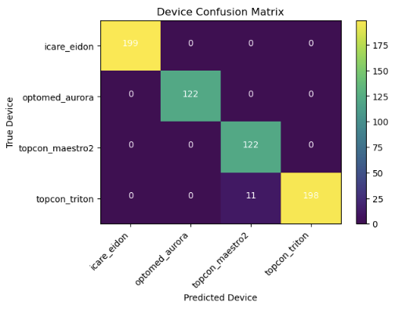

A decision to make!
Model 1: Val accuracy: 79.14%
Model 2: Val accuracy: 85.43%
Model 3: Val accuracy: 98.31%

Slide 26
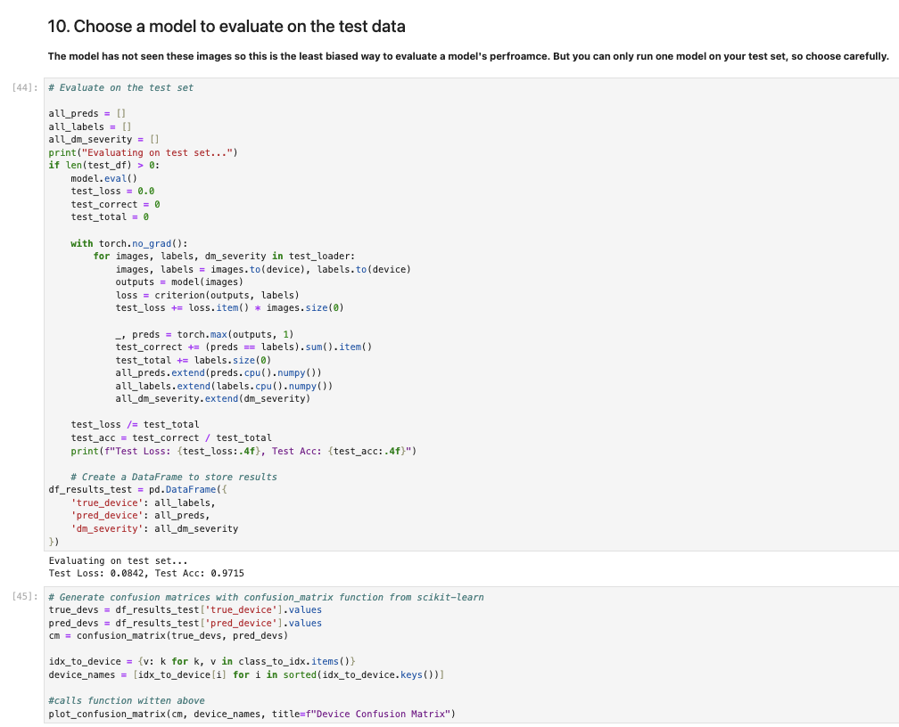

Slide 27
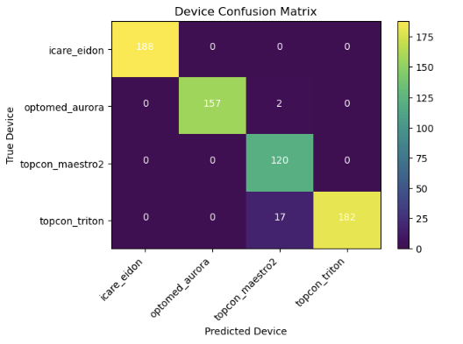
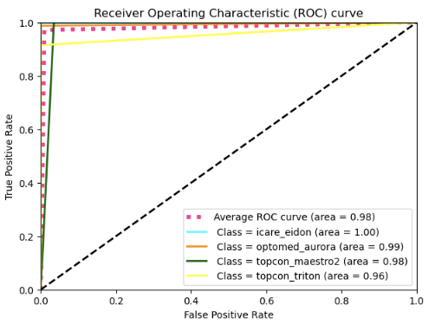
97.5% accuracy!!

Slide 28
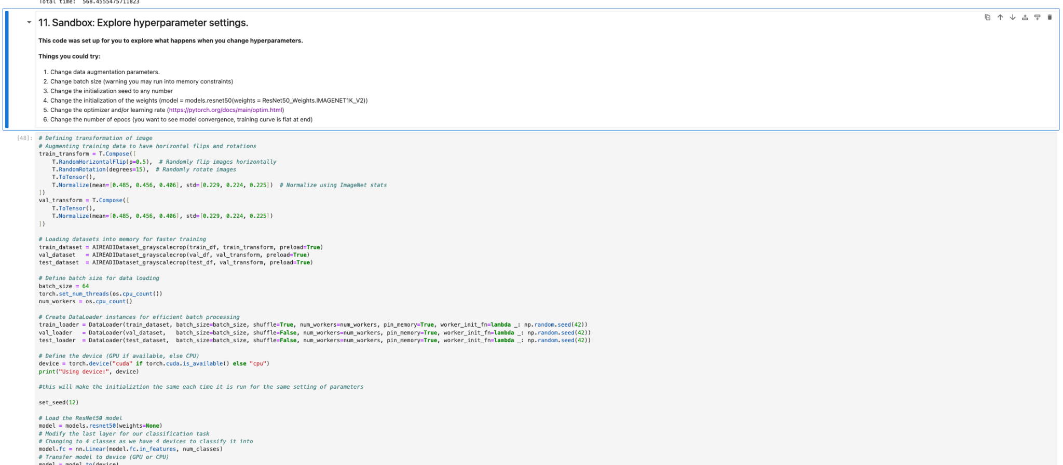
If you have time…..

Slide 29
Acknowledgements
Ravi K. Madduri
Argonne National Laboratory
Aditya Sinha
University of Illinois, Urbana-Champaign
Aaron Lee
University of Washington
All the Lee Lab who helped us test!
Go check out the notebooks later! https://github.com/AdioosinUIUC/aireadi-course

